Slide 1
Software Engineering-IEEE
The application of a systematic,disciplined,quantifiable approach to the development,operation and maintenance of software; that is, the application of engineering to software.
Chapter 2 Software Processes
1

Slide 2
The Software Process
A structured set of activities required to develop a software system.
Many different software processes but all involve:
Specification – defining what the system should do;
Design and implementation – defining the organization of the system and implementing the system;
Validation – checking that it does what the customer wants;
Evolution – changing the system in response to changing customer needs.
A software process model is an abstract representation of a process. It presents a description of a process from some particular perspective.
Chapter 2 Software Processes
3

Slide 3
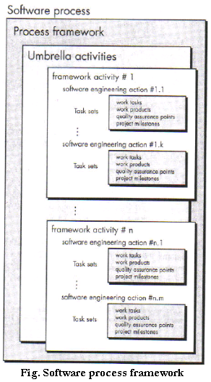
Software Process framework

Slide 4
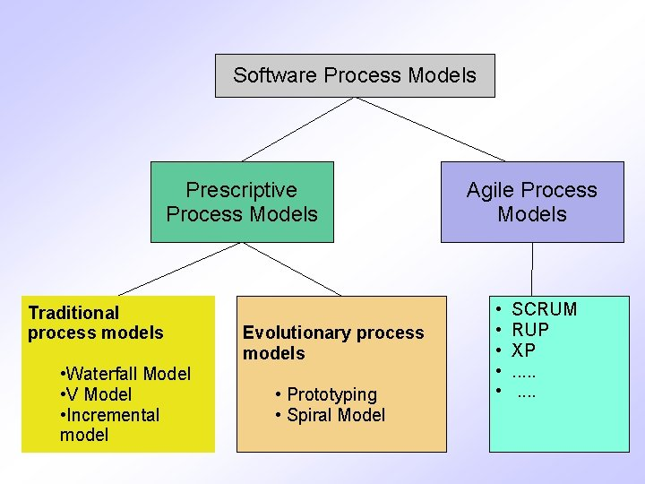
Software Process Model

Slide 5
Software Process Descriptions
When we describe and discuss processes, we usually talk about the activities in these processes such as specifying a data model, designing a user interface, etc. and the ordering of these activities.
Process descriptions may also include:
Products, which are the outcomes of a process activity;
Roles, which reflect the responsibilities of the people involved in the process;
Pre- and post-conditions, which are statements that are true before and after a process activity has been enacted or a product produced.
Chapter 2 Software Processes
4

Slide 6
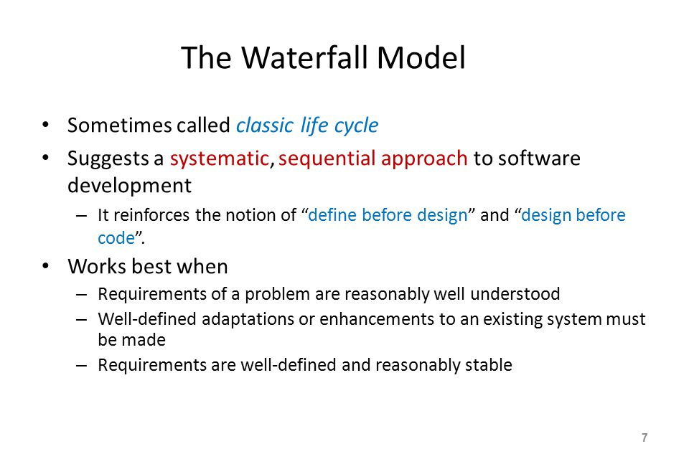
Software Process Models - 1
Chapter 2 Software Processes
6

Slide 7
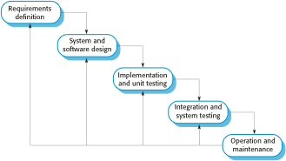
The Waterfall Model
Notice the feedback loops
Chapter 2 Software Processes
8

Slide 8
Waterfall Model Phases
There are separate identified phases in the waterfall model:
Requirements analysis and definition
System and software design
Implementation and unit testing
Integration and system testing
Operation and maintenance
The main drawback of the waterfall model is the difficulty of accommodating change after the process is underway. In principle, a phase has to be complete before moving onto the next phase.
But many issues are true too, such as risk addressing.
Chapter 2 Software Processes
9

Slide 9
Waterfall Model Problems
Inflexible partitioning of the project into distinct stages makes it difficult to respond to changing customer requirements.
Therefore, this model is only appropriate when the requirements are well-understood and changes will be fairly limited during the design process.
Few business systems have stable requirements.
The waterfall model is mostly used for small systems engineering projects where a system is developed at several sites.
In those circumstances, the plan-driven nature of the waterfall model helps coordinate the work.
Chapter 2 Software Processes
10

Slide 10
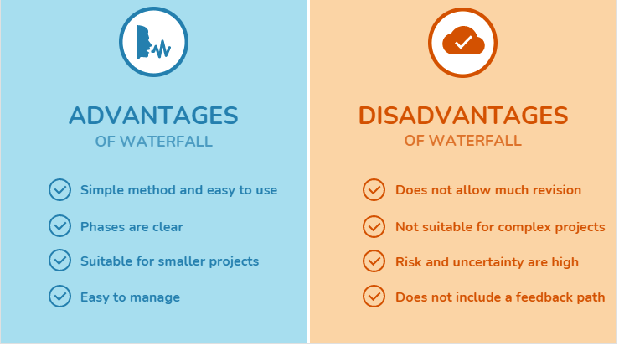

Slide 11
Incremental Model
Incremental Model is a process of software development where requirements are broken down into multiple standalone modules of software development cycle. Incremental development is done in steps from analysis design, imlementation, testing/verification, maintenance.

Slide 12
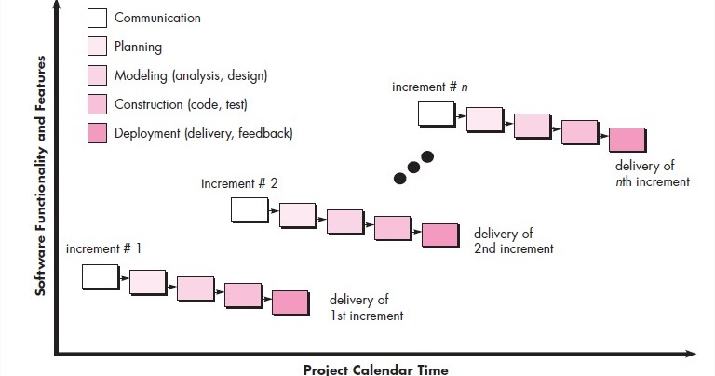

Slide 13
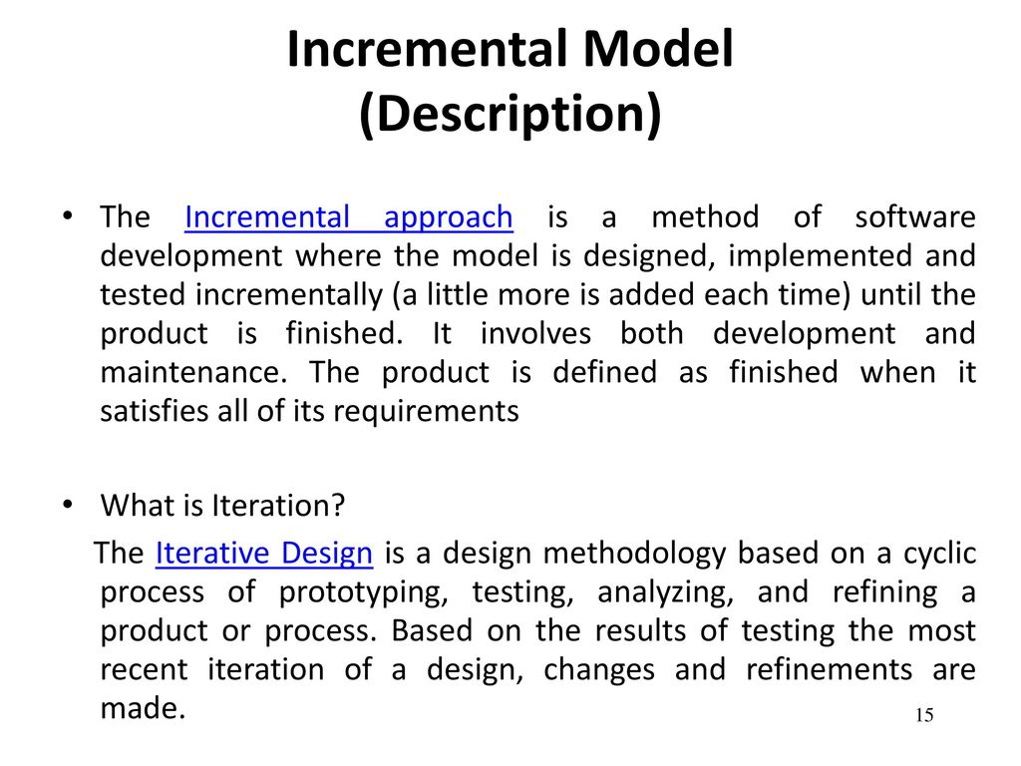
Contd….

Slide 17
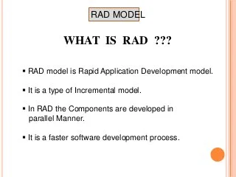
RAD

Slide 18
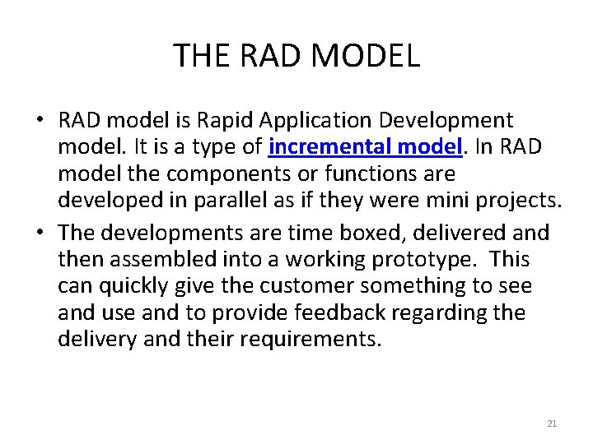
COTND…

Slide 19
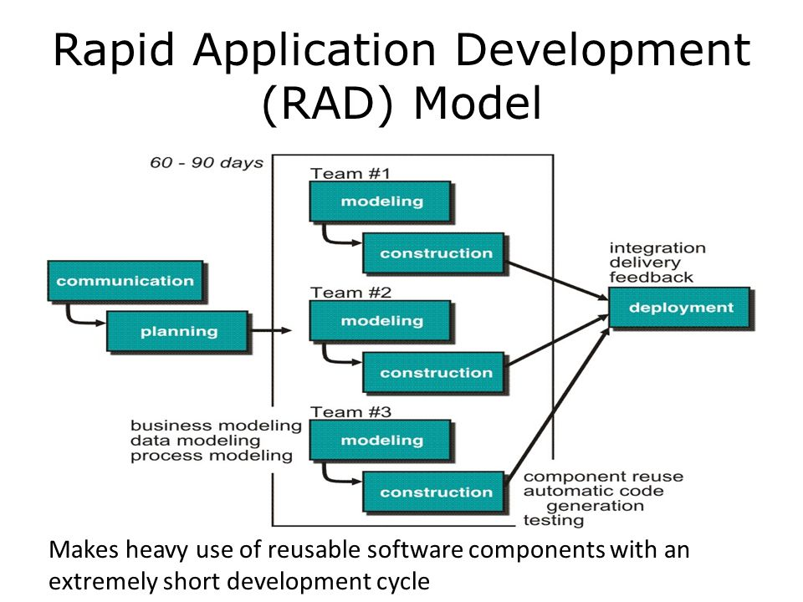

Slide 20
RAD MODEL

Slide 21
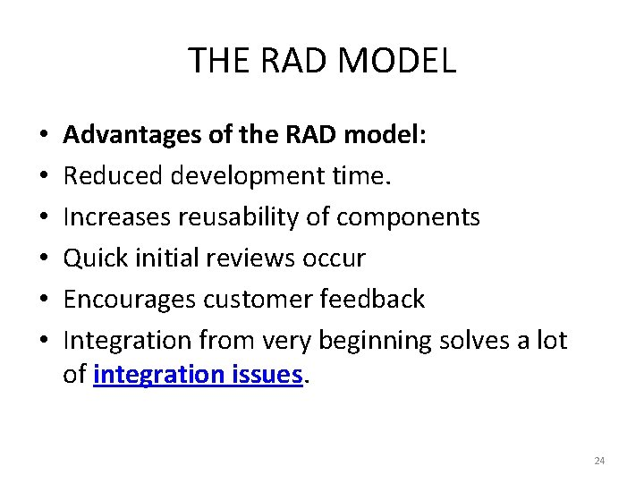

Slide 22
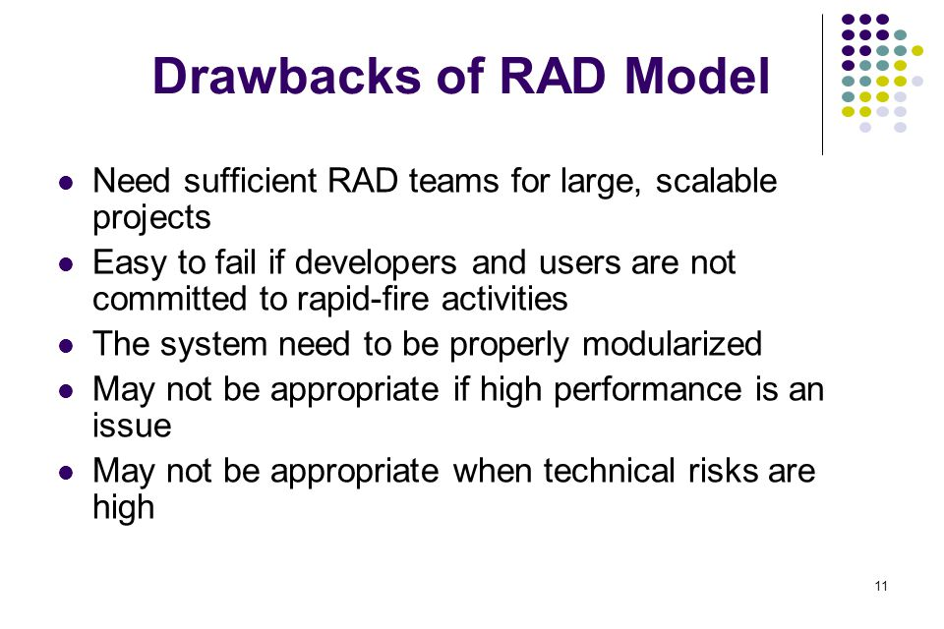

Slide 23
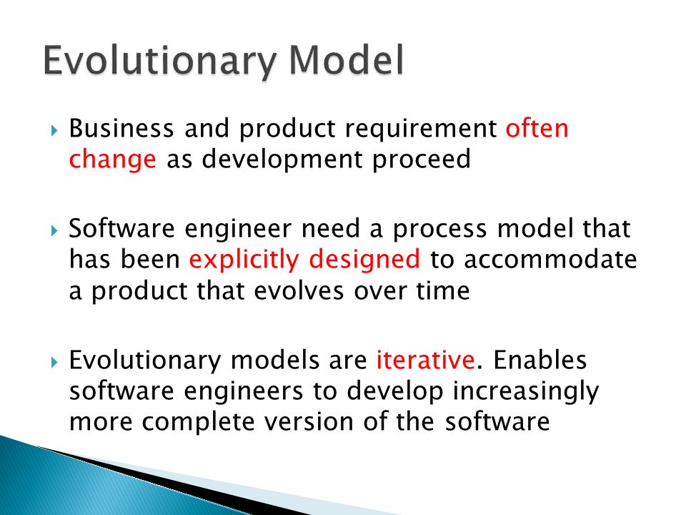
Evolutionary Process Model

Slide 24
Contd..
Evolutionary model is also referred to as the successive versions model and sometimes as the incremental model. In Evolutionary model.
The software requirement is first broken down into several modules (or functional units) that can be incrementally constructed and delivered.
The development first develops the core modules of the system. The core modules are those that do not need services from the other modules.
The initial product skeleton is refined into increasing levels of capability by adding new functionalities in successive versions.
Each evolutionary model may be developed using an iterative waterfall model of development.

Slide 26
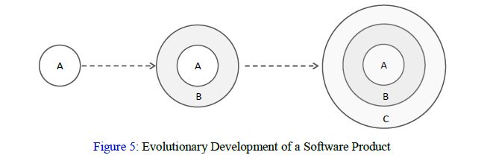

Slide 27
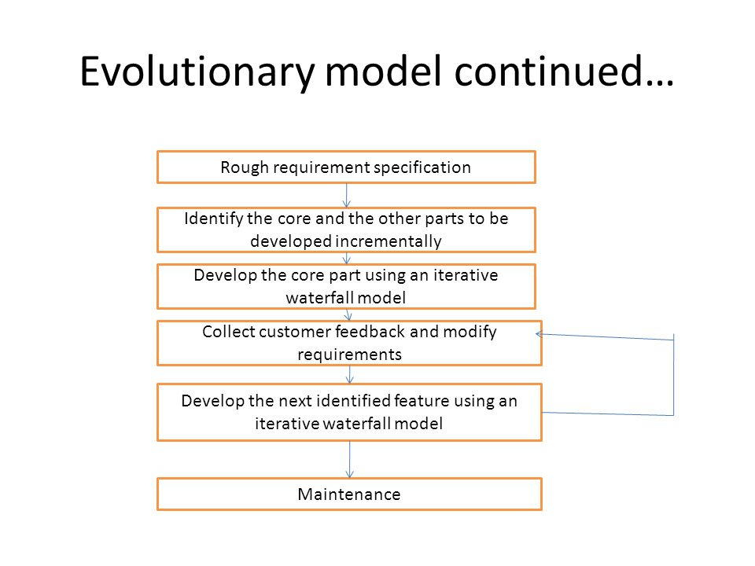
Process of Evolutionary model

Slide 28
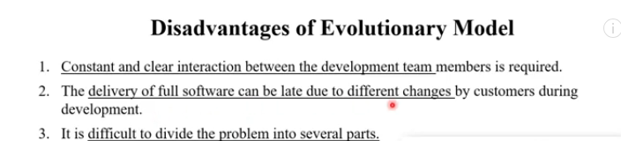
Advantages of Evolutionary Model
Large project: Evolutionary model is normally useful for very large products.
User gets a chance to experiment with a partially developed software much before the complete version of the system is released.
Evolutionary model helps to accurately elicit user requirements during the delivery of different versions of the software.
The core modules get tested thoroughly, thereby reducing the chances of errors in the core modules of the final products.

Slide 30
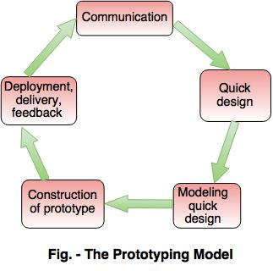
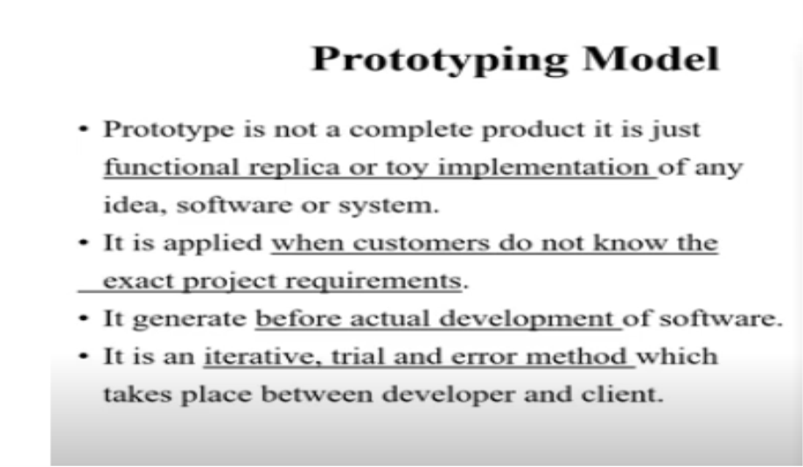
Contd..

Slide 32
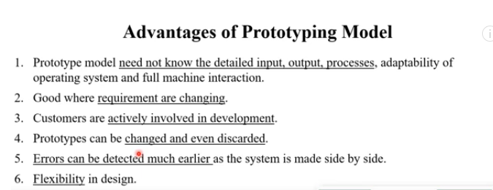

Slide 33
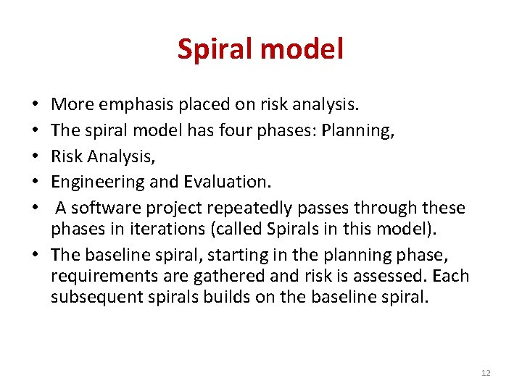
Spiral Model

Slide 35
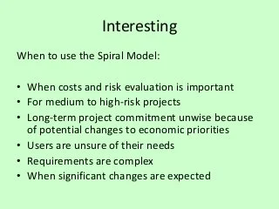
Contd…

Slide 36
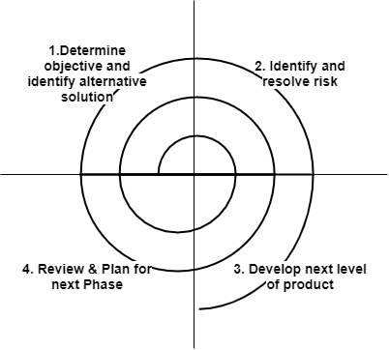

Slide 37
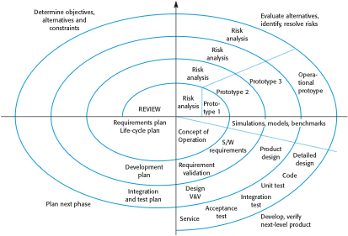
Boehm’s Spiral Model of the Software Process
Chapter 2 Software Processes
12

Slide 38
Spiral Model Sectors
Objective setting
Specific objectives for the phase are identified.
Risk assessment and reduction
Risks are assessed and activities put in place to reduce the key risks.
Development and validation
A development model for the system is chosen which can be any of the generic models. Development takes place.
Planning
The project is reviewed and the next phase of the spiral is planned.
Chapter 2 Software Processes
13

Slide 39
Spiral Model Usage
Spiral model has been very influential in helping people think about iteration in software processes and introducing the risk-driven approach to development.
In practice, however, the model is rarely used as published for practical software development.
Chapter 2 Software Processes
14

Slide 40
Contd..

Slide 45
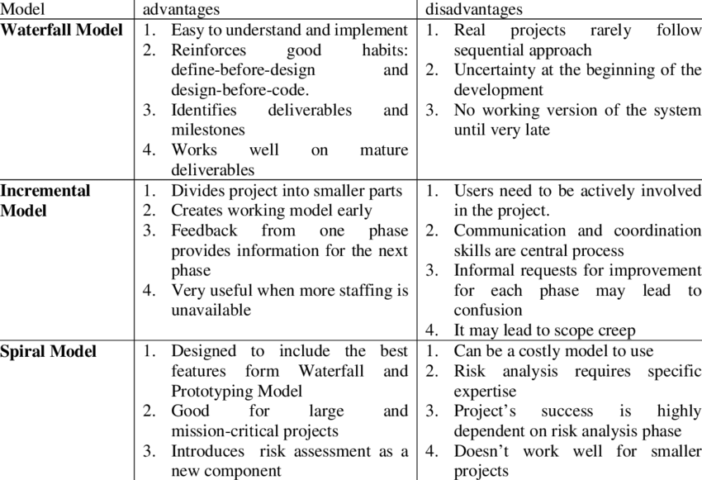

Slide 46
Specialized Process Model
Component Based Development
The component based development model incorporates many of the characteristics of the spiral model.
It is evolutionary in nature, Specialized process model demanding an iterative approach to the creation of software.
Modeling and construction activities begin with the identification of candidate components. These components can be designed as either conventional software modules or object oriented classes or packages of classes.

Slide 47
CONTD….
The component based development specialized process model incorporates the following steps
Available component based products are researched and evaluated for the application domain in question.
Component integration issues are considered.
A software architecture is designed to accommodate the components.
Components are integrated into the architecture.
Comprehensive testing is conducted to ensure proper functionality.

Slide 48
Formal Methods Model
The formal methods model encompasses a set of activities that leads to formal mathematical specification of computer software.
Formal methods enable you to specify, develop, and verify a computer based system by applying a rigorous, mathematical notation.
When formal methods are used during development, they provide a mechanism for eliminating many of the problems that are difficult to overcome using other software engineering paradigms.

Slide 49
Draw Backs:
The development of formal models is currently quite time consuming and expensive.
Because few software developers have the necessary background to apply formal methods, extensive training is required.
It is difficult to use the models as a communication mechanism for Technically unsophisticated customers.

Slide 50
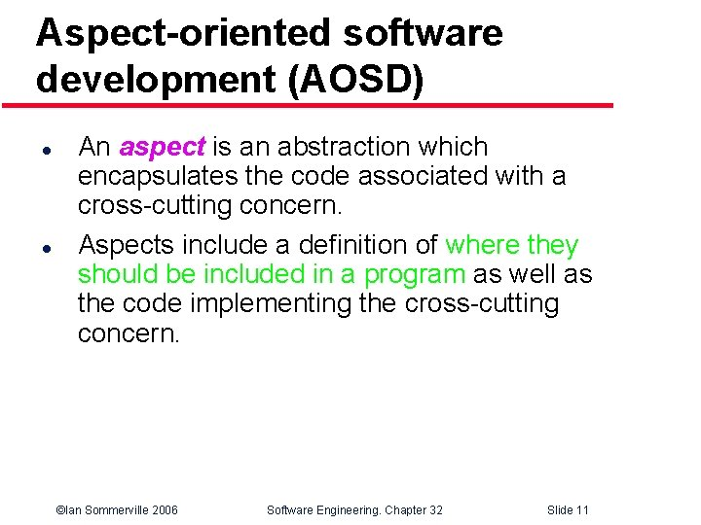

Slide 51
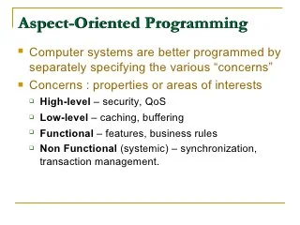

Slide 52
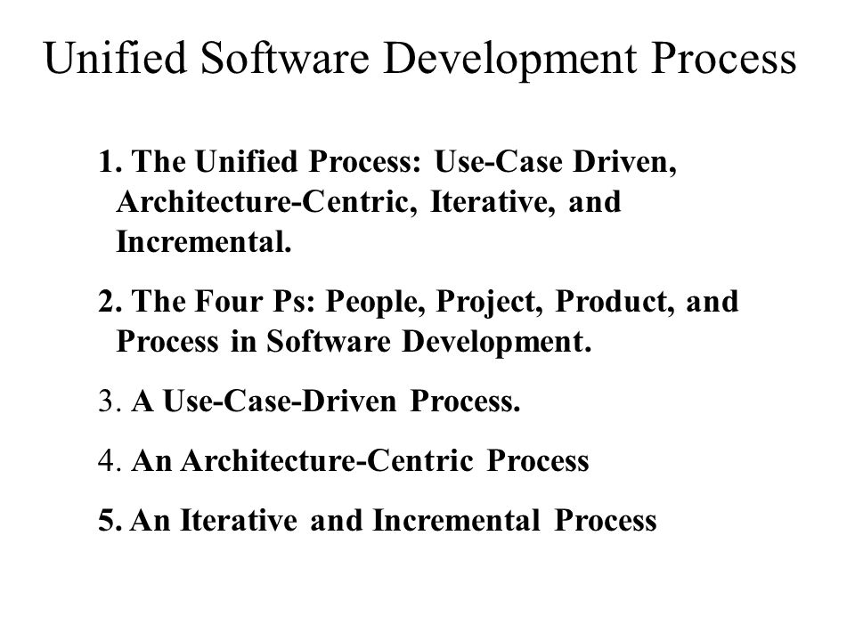

Slide 53
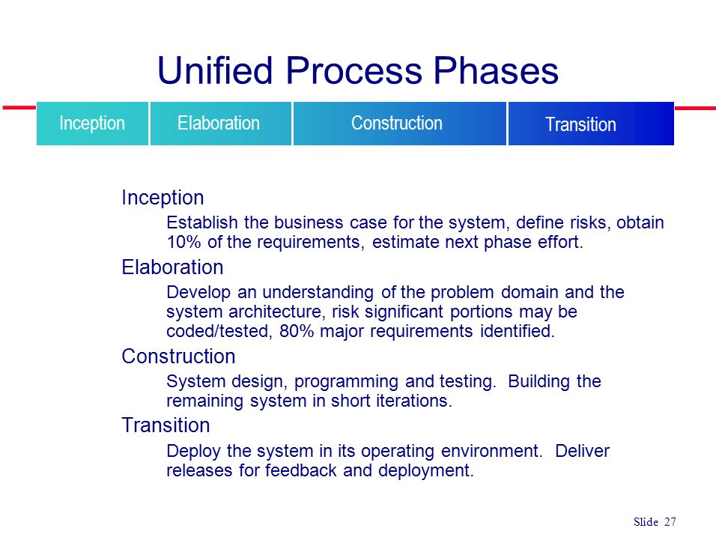

Slide 54
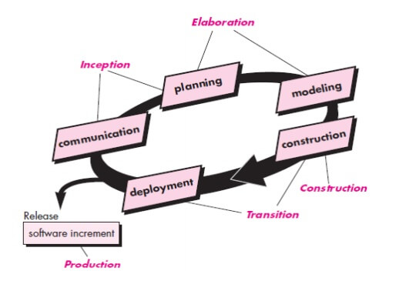

Slide 55
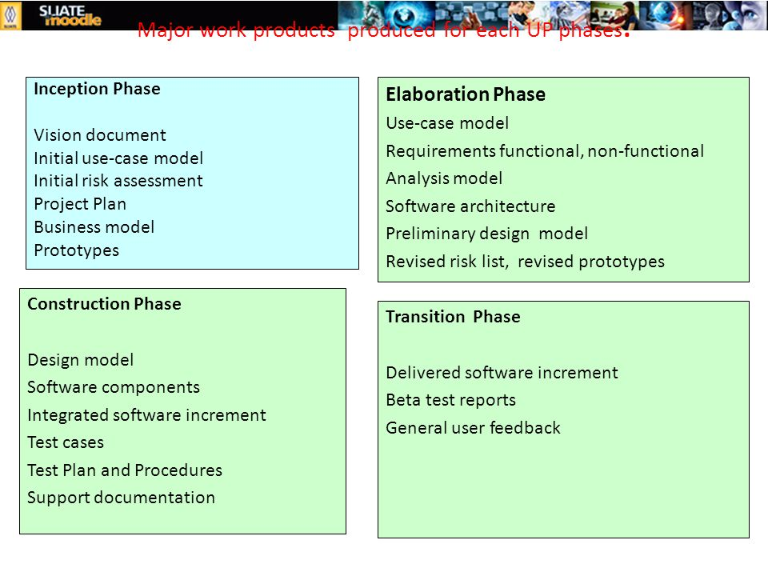
Unified process work products

Slide 56
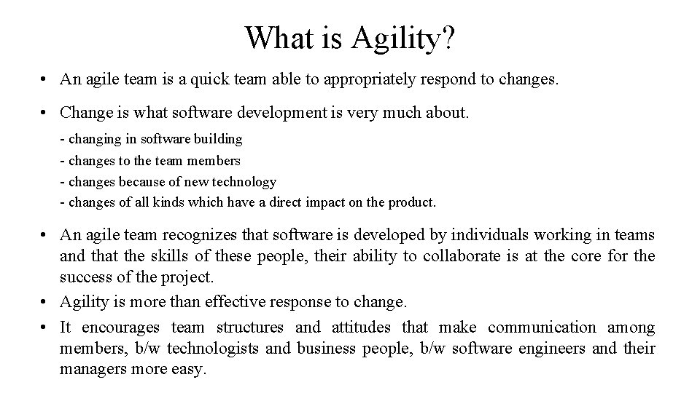

Slide 57
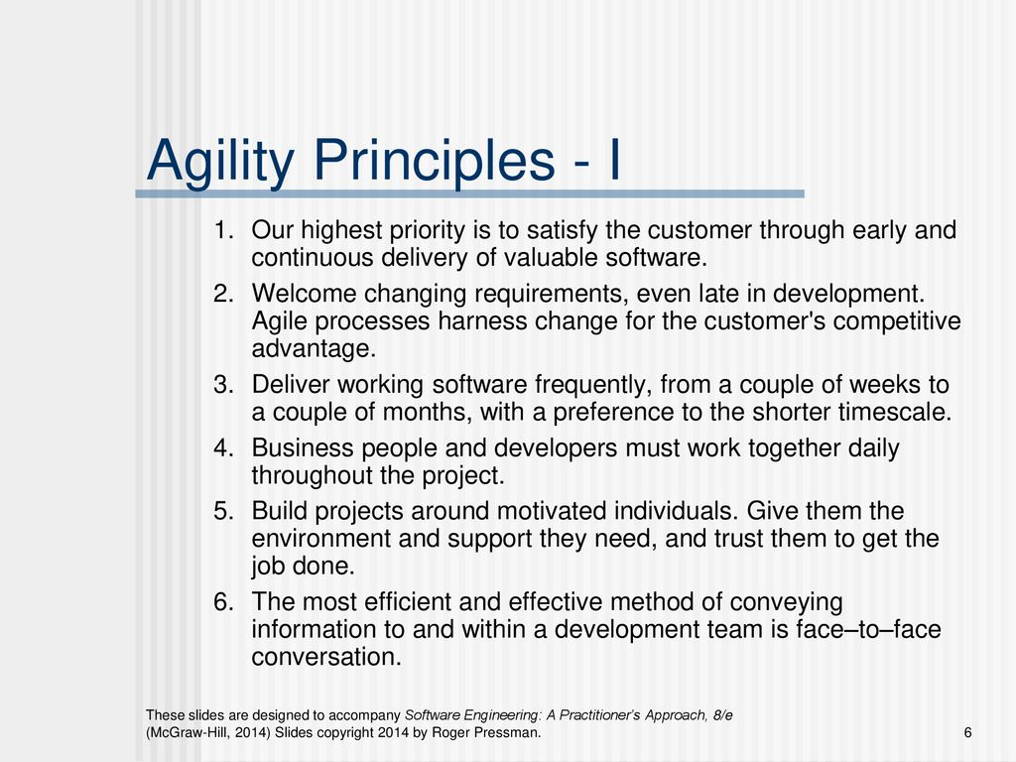

Slide 58
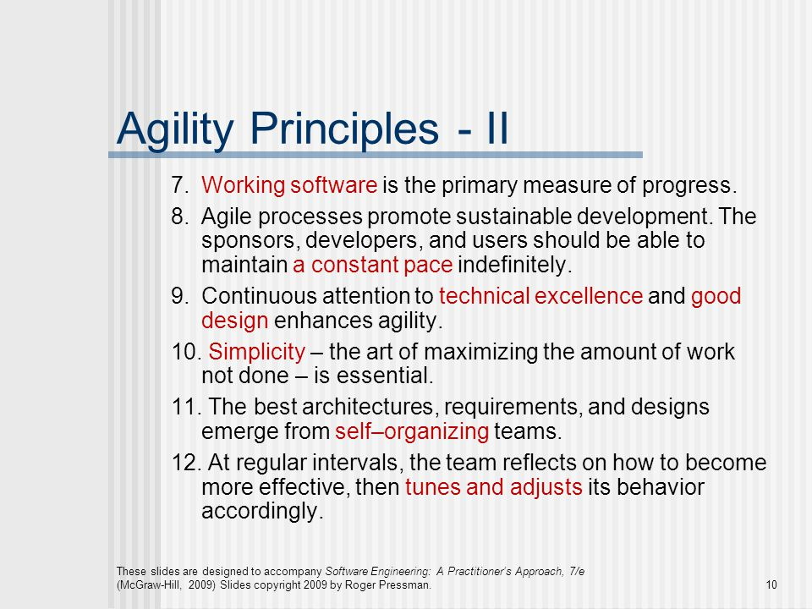

Slide 59
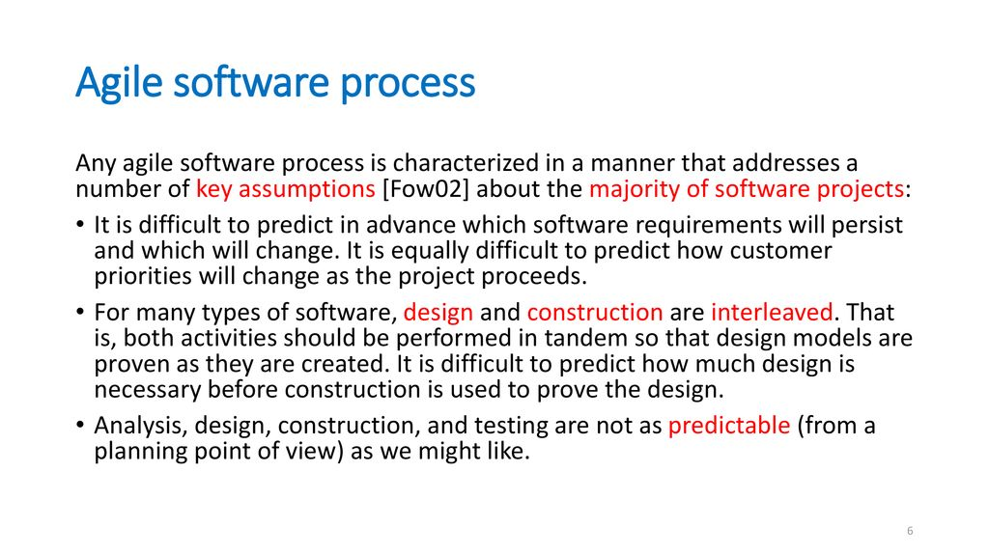

Slide 60
Human Factors
Competence- specific software related skills and overall knowledge of the process that the team has chosen to apply.
Common focus-Although members of the agile team may perform different tasks and bring different skills to the project,all should be focused on one goal.
Collaboration-about assessing analyzing,and using information that is communicated to the software team.

Slide 61
Decision making ability-Any good software team must be allowed the freedom to control its own destiny.This implies that the team is given autonomy decision making authority for both technical and project issues.
Fuzzy problem solving ability-Software managers should recognize that the agile team will continually have to deal with ambiguity and will continually be buffeted by change.
Mutual trust and respect

Slide 62
Contd..
Self organization- the agile team organizes itself for the work to be done.
The team organizes the process to best accommodate its local environment.
The team organizes the work schedule to best delivery of the software increment.

Slide 64
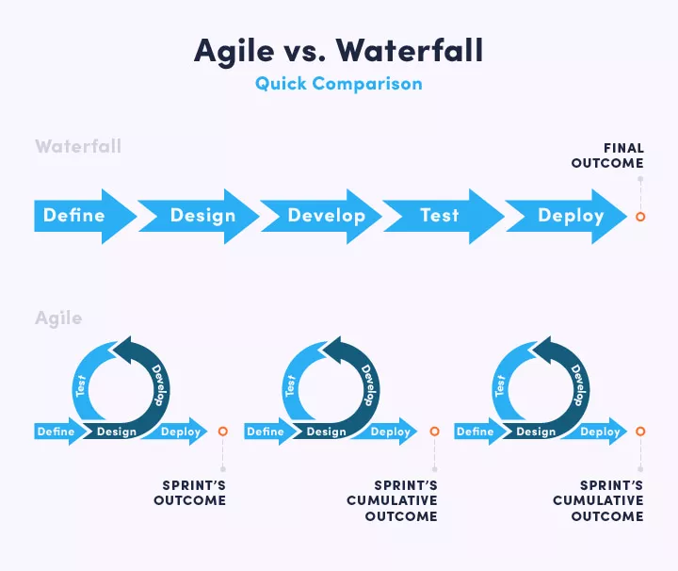

Slide 65
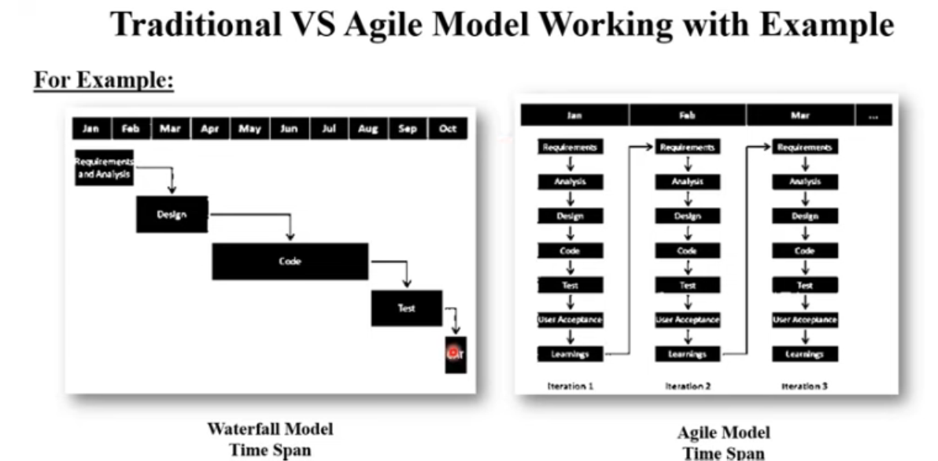

Slide 66
extreme programming(XP)
It was in this environment that Kent Beck created extreme programming (XP), an agile project management methodology that supports frequent releases in short development cycles to improve software quality and allow developers to respond to changing customer requirements.

Slide 67
Contd..
The XP framework normally involves 5 phases or stages of the development process that iterate continuously:
Planning, the first stage, is when the customer meets the development team and presents the requirements in the form of user stories to describe the desired result.
The team then estimates the stories and creates a release plan broken down into iterations needed to cover the required functionality part after part. If one or more of the stories can’t be estimated, so-called spikes can be introduced which means that further research is needed.

Slide 68
Designing is actually a part of the planning process, but can be set apart to emphasize its importance. It’s related to one of the main XP values that we’ll discuss below — simplicity. A good design brings logic and structure to the system and allows to avoid unnecessary complexities and redundancies.
Coding is the phase during which the actual code is created by implementing specific XP practices such as coding standards, pair programming, continuous integration, and collective code ownership

Slide 69
Contd..
Testing is the core of extreme programming. It is the regular activity that involves both unit tests (automated testing to determine if the developed feature works properly) and acceptance tests (customer testing to verify that the overall system is created according to the initial requirements).
Listening is all about constant communication and feedback. The customers and project managers are involved to describe the business logic and value that is expected.

Slide 70
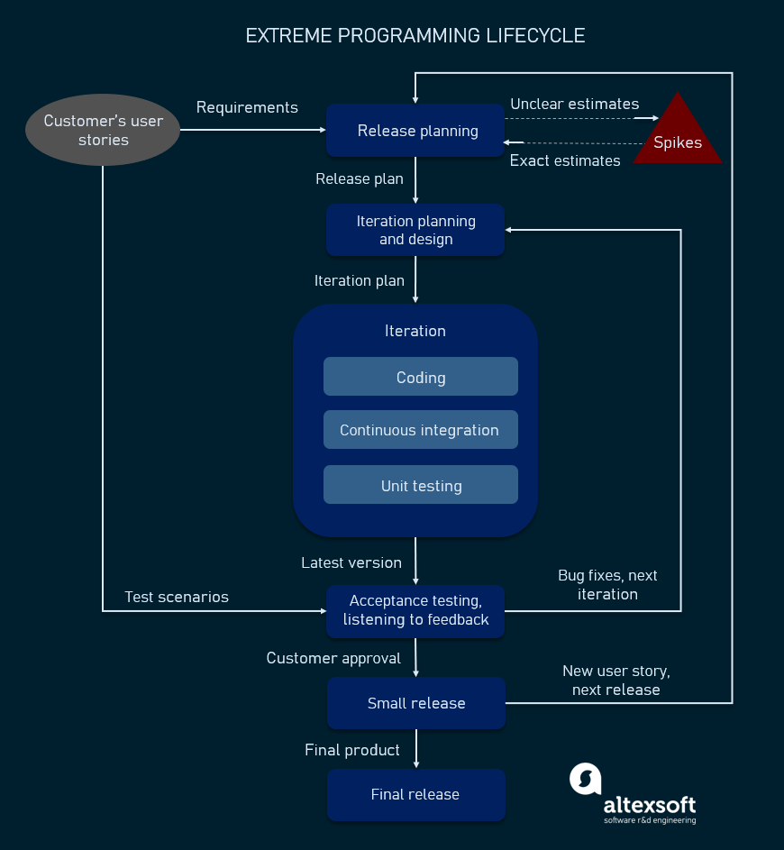

Slide 71
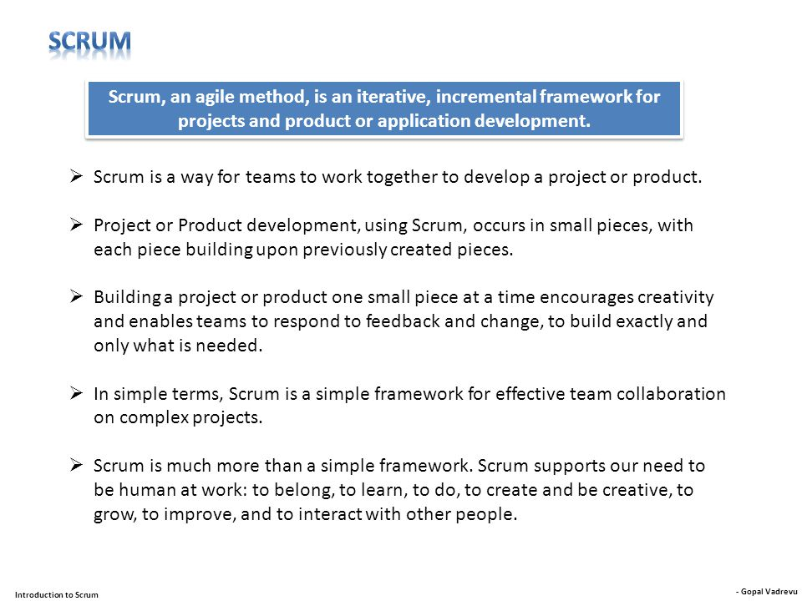

Slide 72
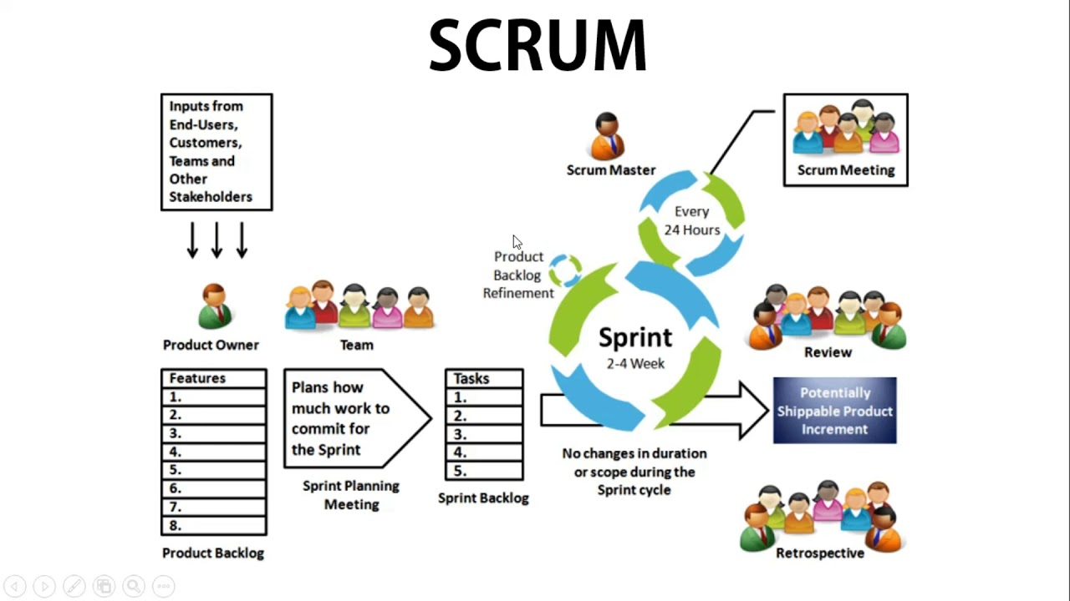

Slide 73
COTND…
Scrum software development starts with a wish list of features — a.k.a. a product backlog. The team meets to discuss:
The backlog.
What still needs to be completed.
How long it will take.
Scrum relies on an agile software development concept called sprints:
Sprints are periods of time when software development is actually done.
Sprint is the basic unit of work for a Scrum team. This is the main feature that marks the difference between Scrum and other models for agile development.
A sprint usually lasts from one week to one month to complete an item from the backlog.
The goal of each sprint is to create a saleable product.
Each sprint ends with a sprint review.
Then the team chooses another piece of backlog to develop — which starts a new sprint.
Sprints continue until the project deadline or the project budget is spent.
In daily scrums, teams meet to discuss their progress since the previous meeting and make plans for that day.
The meetings should be brief — no longer than 15 minutes.
Each team member needs to be present and prepared.
The ScrumMaster keeps the team focused on the goal.

Slide 74
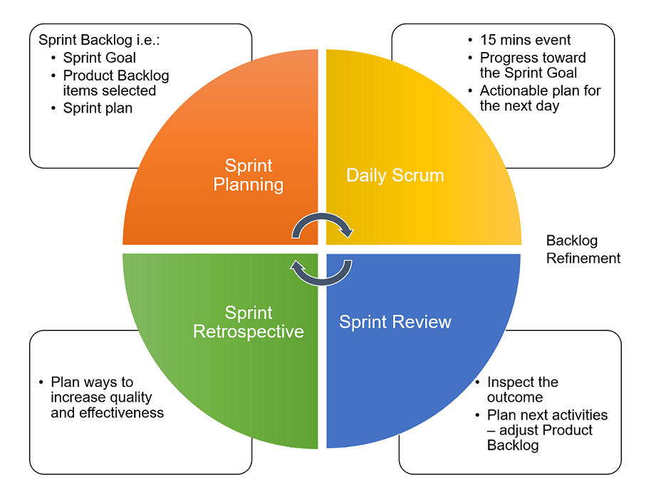

Slide 75
Advantage of using Scrum framework:
Scrum framework is fast moving and money efficient.
Scrum framework works by dividing the large product into small sub-products. It’s like a divide and conquer strategy
In Scrum customer satisfaction is very important.
Scrum is adaptive in nature because it have short sprint.
As Scrum framework rely on constant feedback therefore the quality of product increases in less amount of time

